Slide 1

Farnborough Airport planning application
Increase in weekend flights
Public Zoom call
Wednesday 10th December 2025
Notes:
Being recorded
Slides available afterwards
Doing this because no impartial public consultation by Rushmoor Borough Council
Go through quickly. Presentation will be available afterwards

Slide 2
Key messages
Protect our health and homes
Airport expansion would increase noise and air pollution, harming residents’ well-being, children’s learning and local quality of life as well as impacting property prices
Stop expansion for the ultra-wealthy
The airport serves a tiny elite while creating huge emissions and disruption for local communities. Its growth benefits the few and burdens the many
Stand up for climate and community justice:
Expanding private jet flights undermines Net Zero commitments, Rushmoor Borough Council’s local plan and local efforts to reduce emissions

Slide 3
Planning process
Rushmoor Borough Council non-compliant at every stage
Environmental Impact Assessment – requires evaluation of all “significant” environmental impacts
Planning application
    The Gunning Principles
    The Localism Act 2011
    “Meaningful and independent consultation” of more than 21 days
It is unreasonable to think 2,500 pages of technical documentation can be evaluated and consulted upon in a few weeks, just before Christmas

Slide 4
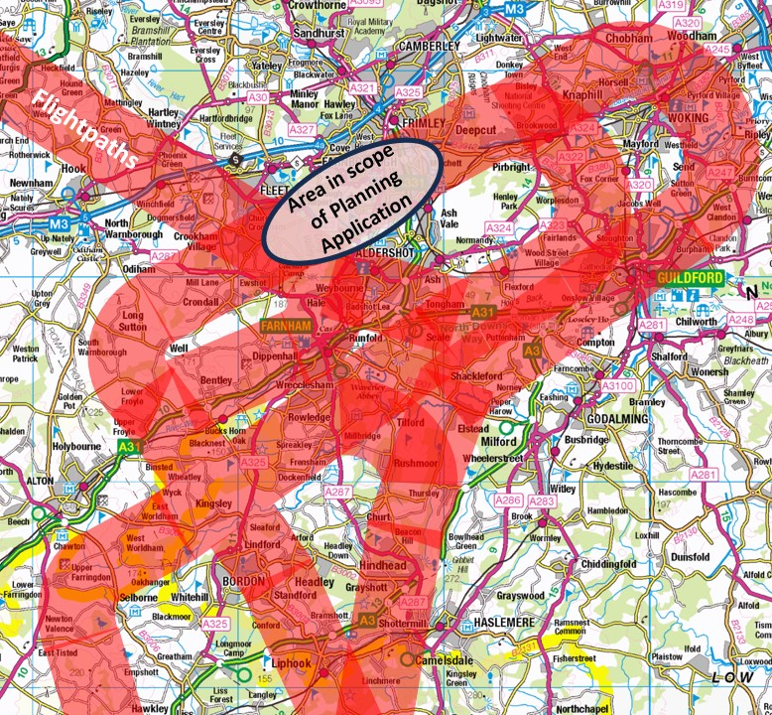
Planning Application scope
WOKING
HOOK
GUILDFORD
CRONDALL
FARNHAM
ALTON
BORDON
HASLEMERE

Slide 5
Do the benefits outweigh the disbenefits?
Benefits
Dis-benefits
Health harm¹
Children’s education harm
Loss of amenity
Environmental harm
Reduction in property values²
Financial benefit to airport
Revenue to Borough
Employment²
Financial benefit to UK PLC¹
1) Additional £540m over 20 years (£80m/year)
2) Additional 650 jobs by 2034
1) 28 – 36,000 deaths. £1.6bn cost/year
www.gov.uk/government/publications/air-pollution-applying-all-our-health/air-pollution-applying-all-our-health
2) 1% reduction in average property value of houses under flightpaths = £1bn
None of the disbenefits are included

Slide 6
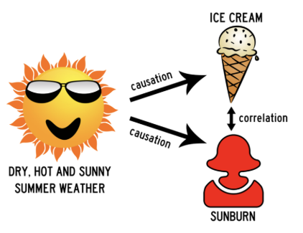
York Aviation’s “Need Case” and “The King’s New Clothes”
  Vast amounts of information without providing base data e.g. survey of airport business park tenants
  Uses reports that pre-date Covid, unpublished green papers, cherry-picks comments to suit its narrative and quotes from reports produced by the aviation industry – Turkeys voting for Christmas?
  Claims no additional emissions from infrastructure – because built last year
  Factors applied to assumptions, applied to sub-sets of data, based on models
  Implies correlation is the same as causation

Slide 7
What the airport is claiming
Fact Check
Wrong!
“The airport brings employment to the area”
  Not the biggest employer. Employs about 200 people – most are low-skilled. Half the airport’s revenue is from fuel sales
  Just a handful of the 70 businesses on the airport business park have any connection with or use of private jets
  Local taxis & hotel accommodation for flight crew, food catering, aircraft maintenance are the businesses that benefit
  Transport (M3, M4, rail, Heathrow) and proximity of tech/service businesses attract other businesses to the area – not access to private jets

Slide 8




Companies House data - 2024
“Profit after taxation amounted to £4,949,243”….
”Taxable losses available to deduct against future taxable profits of £1,133,725”
267 employees
“Financial statement shows a loss after taxation of $57,031,000”
3 employees
“The company incurred a loss after taxation totalling £1,824,237 with liabilities of £3,562,636”
110 employees
“Loss for the year, after taxation, amounted to £8,879,672”
49 employees

Slide 9
What the airport is claiming
Fact Check
Wrong!
“The airport generates revenue for the local economy”
  Passengers arrive in prestige cars/helicopters and don’t spend money locally
  Businesses related to private jets are often offshore or not profitable/paying tax
  Flights reduce the value of people’s homes
  RBC could generate millions more income if it turned the area into a solar farm and could supply about half of all Rushmoor’s electricity needs

Slide 10
What the airport is claiming
Fact Check
Wrong!
“The airport generates income for the country”
  £700m debts/liabilities. Pays £50m a year to Macquarie as dividends and interest
  Claims growth by attracting private jet flights from other airports. It doesn’t include the loss of jobs from those areas. No net benefit to the UK
  Business aviation has fallen 50% since 2019. Weekend flights are generally leisure flights
  Leisure flights don’t generate value - they export it because the ultra-wealthy spend their money in foreign destinations

Slide 11
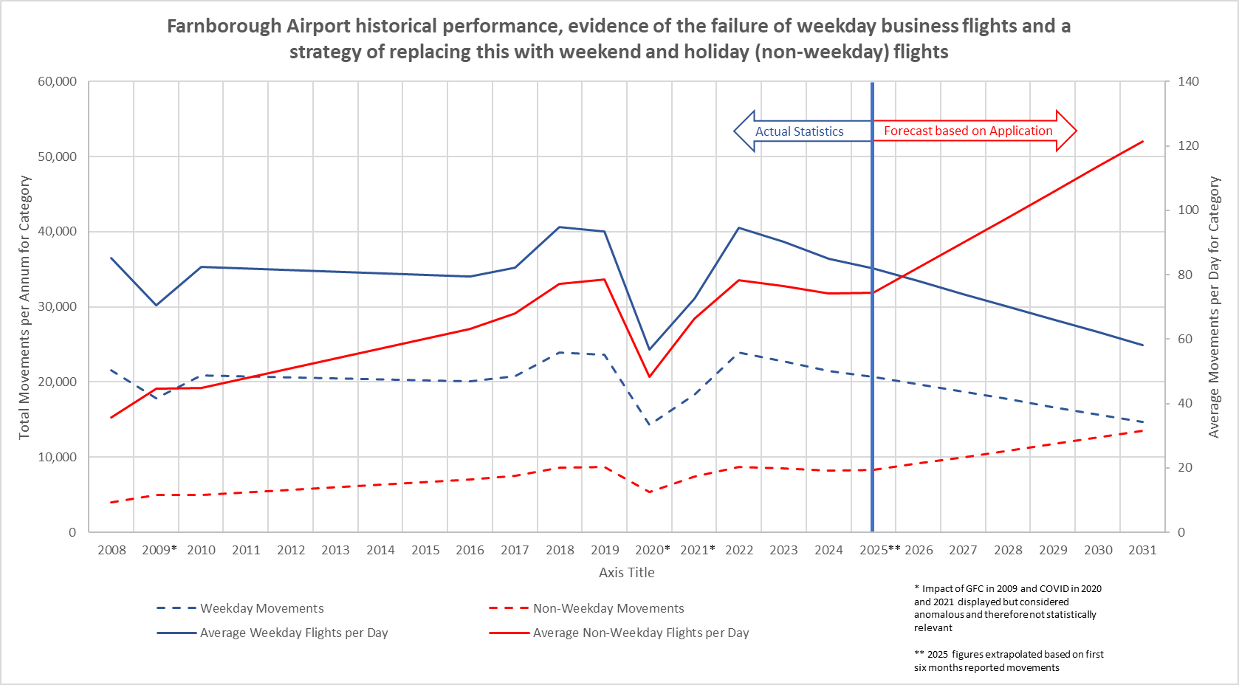
Rushmoor Local Plan limits number of weekend flights
Weekends flights should be no more than 50% of weekday flights
Rushmoor Local Plan 7.110
Tom Burton

Slide 12
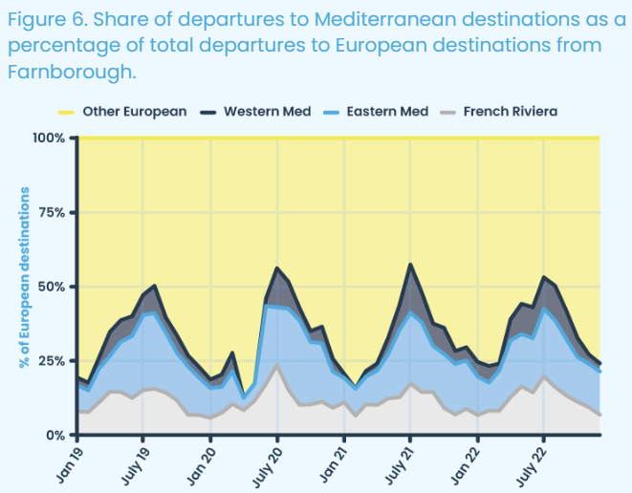
They aren’t all business flights – especially at weekends
“Jetting away with it”
How private jets pollute the most and pay the least”
Possible, July 2023

Slide 13
The false narrative the airport has put out
“Farnborough is the birthplace of aviation”
  So what? That was more than 100 years ago. How does that drive growth now?
“People chose to live next to an airport”
  Shorter hours & fewer flights before 2003 (when a military airfield)
  New flightpaths in 2020. Houses up to 15 miles from the airport in quiet rural areas suddenly had a twenty-fold increase in flights
  150,000 dwellings under the flightpaths. More than 30,000 dwellings scheduled to be built along the A31 corridor, directly under the airport’s flightpaths
“There isn’t an increase in flights”
  Increase is below the 50,000 cap, but still 50% increase on weekend flight cap
“It’s easier to get to than Heathrow for my holiday”
  Farnborough isn’t and never will be a commercial airport for scheduled flights

Slide 14
Why is expansion even being considered?
  Airport only has a licence for business and charter flights
  2.5 passenger/plane. 40% fly empty. Highest emissions of any form of transport
  Breaches RBC’s Local Plan for all transport to reduce emissions
  66% of planes operating are large “long-haul” but 88% of flights are to UK/Europe (planning application data). Why are bigger planes needed?

Slide 15
i.e. They need it to make more money, we don’t need it
Main issues – The “need” case
  None of the negative impacts included (harm, property prices, etc)
  No sensitivity analysis – just a “best case” scenario
  No recognition of potential impact on flight numbers from SAF, fuel tax, carbon capture, destination restrictions, etc
  Document proposes a causation between private jet flights and UK GDP. No information provided to support such a claim

Slide 16
Main issues - Noise
  Only considering impact of noise from Farnborough aircraft – all noise should be included
  Only considering “average noise” - volume, frequency and time of noise is the issue
  Noise has been modelled on defined flightpaths/heights - planes don’t follow these flightpaths so models are flawed
  Limits were put on weekend flights by the SoS when approval was given for the increase to 50,000 movements in 2011. This was to recognise the particular disturbance to amenity caused by aircraft noise at weekends

Slide 17
Main issues - Emissions
  Only considering a fraction of emissions (up to 3,000ft)
  Non-CO2 emissions incorrectly excluded from scope¹ (this doubles recorded emissions)
  Climate Change Committee (and others) advise against any airport expansion until operators can demonstrate a pathway to net zero
  Aviation’s emissions increasing – not decreasing in line with aviation’s Jet Zero strategy or legally binding Net Zero by 2050
1 - https://www.transportenvironment.org/uploads/files/Open-Advice-re-Inclusion-of-non-CO2-aviation-emissions-in-NDCs-25-7-25-final-1_2025-08-27-111026_upvk.pdf

Slide 18
Main issues - Pollution
  NO_{X} exceeds World Health Organisation “safe” levels
  Ultrafine particles not measured (a significant harm to human health)
  “Forever” chemicals in Cove Brook not even noted
  Nitrite in SSSI protected area exceeds safe levels
  Odour (jet fumes) excluded
  Vibration excluded

Slide 19
Main issues – Harm to human health
  Section 12 of application – Impact on human health. Read it and ask why the airport even exists
“A large-scale study around Heathrow Airport found that people living under the flightpath were 10-20% more at risk of stroke and heart disease than those not living under the flight path”
“Ultrafine particles from planes put 52 million Europeans at risk of serious health conditions”
“The noise of your plane whisking you away could be damaging their health, putting them at greater risk of developing cardiometabolic diseases, a cluster of conditions that includes heart attack, stroke, diabetes, and hypertension”
“There is evidence to suggest that chronic aircraft noise has a deleterious effect on children’s memory, sustained attention, reading comprehension and reading ability

Slide 20
Main issues – Environment
  Most of the area under flightpaths is highly protected National Landscapes for public wellbeing, afforded high environmental protection status
  Significant number of highly protected and red-list species under flightpaths
  Air Navigation Guidance 2017 should be applied
  CPRE, National Landscapes, Natural England have raised significant concerns regarding environmental harm

Slide 21
This application, not the full story
  RBC rushing to get application through before local elections
  Final reading of “Planning and Infrastructure Bill”. Will relax environmental requirements on developments
  Expect 2023 application (70,000 flights, doubling of weekend flights, larger aircraft) to be continued

Slide 22
Questions & discussion
Useful information
Facebook page – https://www.facebook.com/groups/farnboroughnoise
Email address - farnboroughnoisegroup@gmail.com
Web page - www.farnboroughnoise.org

Slide 23
Reference information
Article/Report | Publisher | Date
Health impact - Noise
Aircraft noise: a long standing problem | AEF
Noise pollution: mapping the health impacts of transportation noise in England | UK Health Security Agency | Jun-23
Airplane Noise May Be Bad for Your Health | Boston University | Jun-24
Exposure to aircraft noise linked to worse heart function | UCL | Jan-25
Health impact - Particulates
Unseen but Dangerous: Understanding the Health Risks of Ultrafine Particles in Ambient Air | AVL | Oct-24
Ultrafine particles from planes put 52 million Europeans at risk of serious health conditions | Transport and Environment | Jun-24
Health impact - NOx, SO2
A link between air travel and deaths on the ground | MIT Laboratory | Jun-24
Children’s education impact
Aircraft Noise and Children’s Learning | ERCD Report | Feb-10
Traffic noise slows children’s memory development | The Guardian | Jun-22
How a little more silence in children's lives helps them grow | NPR | May-23
How traffic noise hurts children's brains | BBC | Jun-24
The effect of environmental noise on children’s reading ability and behaviour in Europe | European Environment Agency | Dec-24
Economic case for airport expansion
Wider Economic Impacts of Regional Air Connectivity | Peak Economics for DfT | Nov-18
Losing altitude - The economics of air transport in Great Britain | New Economic Forum | Jul-23
Majority in Europe reject aviation’s claim to boost economic growth | Travel Weekly | Jun-24
The economic impact of airport expansion in the south-east | New Economics Foundation | Jan-25
Government failed to produce evidence for airport expansion growth claims | New Economics Foundation | Oct-25
Economics of air transport in Europe | T&E | Nov-25
Private jet emissions
Just Plane Wrong: Celebs with the Worst Private Jet Co2 Emissions | Yard | Jul-22
Jetting away with it | Possible | Jul-23
Private aviation is making a growing contribution to climate change | Nature | Nov-24
Unsafe for takeoff: False solutions will not help aviation sector navigate climate crisis | Carbon Market Watch | Dec-24
The Curious Case of Top CEOs’ Private Jet Emissions | Carbon Credits | Jan-25
Private jets emitted more climate pollution than all flights departing Heathrow Airport in 2023 | ICCT20 | Jun-25
Private Jet non-CO2 impacts
Clouds created by aircraft have a bigger impact than the emissions they emit | Imperial College | Nov-22
Literature review of aviation’s non-CO2 climate impacts and evaluation of existing metrics | DfT | May-24
What share of global CO₂ emissions come from aviation? | Our World in Data | Apr-24
Greenwashing
Is it time for the aviation industry to brace itself against greenwashing claims? | Howard Kennedy | Mar-24
European crackdown on airlines’ bogus eco claims | ICLG | May-24
Why aviation’s green promises face growing legal risks | Air Cargo Week | Nov-25
SAF misinformation
Biofuels Factsheet | Stay Grounded | May-25
Biofuels globally emit more CO2 than the fossil fuels they replace | T&E | Oct-25
The aviation industry’s dirty tactics | New Statesman | Nov-25
Other
OBR has warned that the costs of failing to achieve Net Zero will exceed those of achieving it | Office of Budget Responsibility | Oct-21

